Slide 1
CELEBAL TECHNOLOGIES -
INTERNSHIP PROJECT

Slide 2
Optical
Character Recognition
Faculty Mentor (UPES) :
Mr. Bikram Pratim Bhuyan
Team Lead (Celebal):
Mr. Anurag Sharma
Team members :
Shreya Joshi
Shubham Sanghi
Suvansh Kapur
M. Sweety Reddy

Slide 3
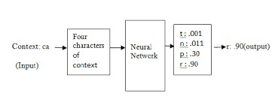
Objective
The goal of the project was to predict the next character from the previous set of words or sentences.

Slide 4
Target Audience
Optical Character Recognition (OCR) Systems Market By Offering (Software [Desktop-Based OCR, Mobile-Based OCR, and Cloud-Based OCR {Multi-Tenant Cloud and Private Cloud}], Services [Consulting, Outsourcing, Implementation, and Integration], and Others), and Industry Vertical (Retail, BFSI, Government, Education, Healthcare, Transport & Logistics, Media & Entertainment, IT & Telecommunication, and Manufacturing).

Slide 5
Literature Review
On reviewing some of the papers published by IEEE we were able to conclude:
· Given the universality of manually written archives in human exchanges, Optical Character Recognition (OCR) of records have significant commonsense worth.Optical person acknowledgment is a science that empowers to decipher different sorts of archives or pictures into analyzable, editable and accessible information.
· During last decade, analysts have utilized computerized reasoning/AI devices to consequently examine written by hand and printed reports to change over them into electronic organization.
· The goal of this survey paper is to sum up research that has been led on character acknowledgment of transcribed archives and to give research headings.In this Systematic Literature Review (SLR) we gathered, blended and examined research articles on the subject of transcribed OCR (and firmly related points) which were distributed between year 2000 to 2019.
· We followed generally utilized electronic information bases by following pre-characterized survey convention. Articles were looked through utilizing catchphrases, forward reference looking and in reverse reference looking to look through every one of the articles identified with the subject.
· After cautiously following investigation determination measure 176 articles were chosen for this SLR. This survey article effectively presents best in class results and procedures on OCR and furthermore give research headings by featuring research holes.

Slide 6
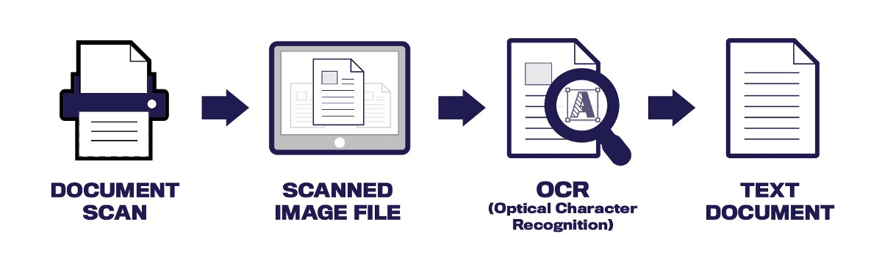
Introduction
OCR takes images that include textual elements and attempts to recognize that text. The output is a text string, and accuracy is measured as the degree of similarity between the recognized text and the text a human would be able to read from the image.
OCR is used to recognize printed text in paper documents, handwritten characters, and text elements in the physical environment, such as license plate numbers, street signs, and street numbers.
Traditional OCR algorithms are based on pattern matching, pattern recognition, or image correlation. These techniques, in a standard use case such as a document scanner, can recognize words and sentences with a very high level of accuracy.

Slide 7
Modern OCR Use Cases
OCR is an age-old technology that’s used in countless software programs and hardware devices. However, new use cases are evolving that are taking OCR capabilities to the edge:
Parking validation — Cities and towns are using mobile OCR to automatically validate if cars are parked according to city regulations. Parking inspectors can use a mobile device with OCR to scan license plates of vehicles and check with an online database to see if they are permitted to park.
Mobile document scanning — A variety of mobile applications allow users to take a photo of a document and convert it to text. This OCR task is more challenging than traditional document scanners, because photos have unpredictable image angles, lighting conditions, and text quality.
Digital asset management (DAM) — Digital asset management software helps organize rich media assets such as images, videos, and animations. A key aspect of DAM systems is search-ability of rich media. By running OCR on uploaded images and video frames, DAM can make rich media searchable, and enrich it with meaningful tags.

Slide 8
Deep Learning OCR Models
Text recognition involves two steps: first, detecting and identifying a bounding box for text areas in the image, and within each text area, individual text characters. Second, identifying the characters.
To detect characters and words in images, you can use standard deep learning models, like Mask RCNN, SSD, or YOLO. However, deep learning models that are good at identifying objects in images (i.e. animals or vehicles), can find it difficult to identify text characters, and may perform worse than legacy OCR algorithms discussed above.
Therefore, specialized deep learning models have evolved to help localize and detect text in images. Here are several commonly-used models.

Slide 9
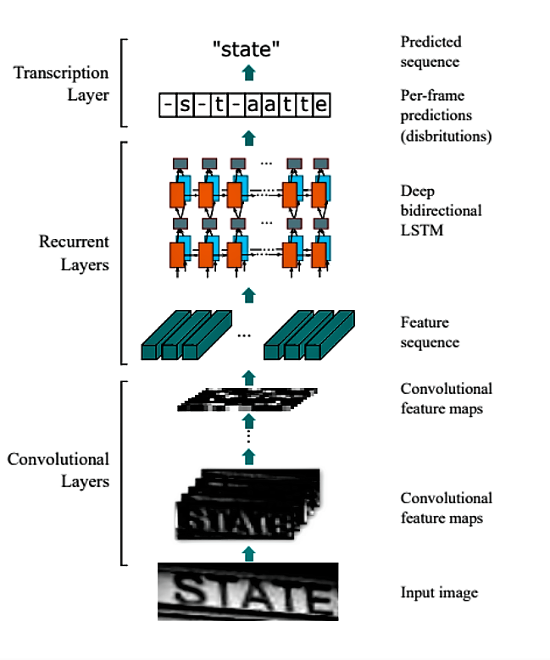
Technology Used
Convolutional-Recurrent Neural Network (CRNN)
The CRNN approach identifies words using three steps:
A standard convolutional neural network (CNN) — the first layer breaks the image into features and is divided into “feature columns”.
These columns are fed into a deep-bidirectional long short term memory (LSTM) cell, which provides a sequence, identifying the relationship between the characters.
The output of the LSTM cell is fed into a transcription layer, which takes the character sequence, including redundant characters, and uses a probabilistic approach to clean the output.

Slide 10
Methodology(Project Demonstration)
1. Preprocessing: The raw data is subjected to a number of preliminary processing steps to make it usable in the descriptive stages of character analysis. Pre-processing aims to produce data that are easy for the OCR systems to operate accurately. The various tasks performed on the image in pre-processing stage includes batch normalization (also known as batch norm) is a method used to make artificial neural networks faster and more stable through normalization of the layers' inputs by re-centering and re-scaling. Batch normalization is applied after every convolutional block to speed up the training.
2. Feature Extraction: This step is the core of the framework. It characterizes each character by the presence or non appearance of key highlights and these key highlights may height, width, thickness, circles, lines, stems and other characteristics. Each character is passed judgement on dependent on these attributes and fundamental highlights. The information is limited by saving just the required data. This will give us a vector with scalar qualities. Highlights are removed similarly as in the preparation part and the highlights of the character to be perceived is stored in independent vector.

Slide 11
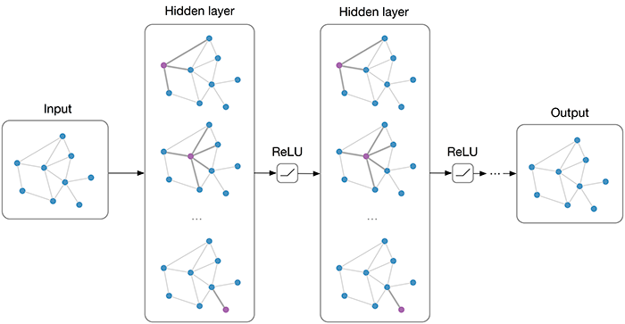
3. Training: Training One part of the program trains the network to recognize the characters. This network takes input-output vector pairs during training. The network trains its weight array to minimize the selected performance measure, i.e., error using back propagation algorithm.
4. Testing: After training model is tested on the test dataset and the results are evaluated.

Slide 12
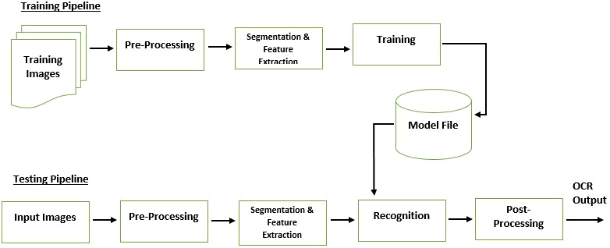

Slide 13
PseudoCode/ Algorithm (OCR)
def OCR Model():
(1) //taking image as input and defining 1st convolutional layer
image=keras.layers.Input((32,784,1))
conv1=keras.layers.Conv2D(16,(3,3),activation='relu',padding='same')(image)
(2) //applying Max pooling and defining 2nd convolutional layer
mp1=keras.layers.MaxPooling2D((2,2),padding='same')(conv1)
conv2=keras.layers.Conv2D(32,(3,3),activation='relu',padding='same')(mp1)
(3) //applying Max pooling and defining 3rd convolutional layer
mp2=keras.layers.MaxPooling2D((2,2),padding='same')(conv2)
conv3=keras.layers.Conv2D(64,(3,3),activation='relu',padding='same')(mp2)

Slide 14
(4) //applying Max pooling and defining 4th convolutional layer
mp3=keras.layers.MaxPooling2D((2,2),padding='same')(conv3)
conv4=keras.layers.Conv2D(128,(3,3),activation='relu',padding='same')(mp3)
(5) //applying Max pooling and defining 5th convolutional layer
mp4=keras.layers.MaxPooling2D((2,1),padding='same')(conv4)
conv5=keras.layers.Conv2D(256,(3,3),activation='relu',padding='same')(mp4)
(6) //applying Max pooling and defining 6th convolutional layer
mp5=keras.layers.MaxPooling2D((2,1),padding='same')(conv5)
conv6=keras.layers.Conv2D(256,(3,3),activation='relu',padding='same')(mp5)
(7) //applying Batch Normalization
bn=keras.layers.BatchNormalization()(conv6)
sq=keras.backend.squeeze(bn,axis=1)

Slide 15
(8) //Using LSTM model
rn1=keras.layers.Bidirectional(keras.layers.LSTM(256,return_sequences=True))(sq)
rn2=keras.layers.Bidirectional(keras.layers.LSTM(256,return_sequences=True))(rn1)
(9) // using Softmax Activation Function
exd=keras.backend.expand_dims(rn2,axis=2)
maping=keras.layers.Conv2D(len(symbols),(2,2),activation='relu',padding='same')(exd)
maping=keras.backend.squeeze(maping,axis=2)
maping = tf.keras.layers.Softmax()(maping)
(10) // using Adam optimizer to compute loss
model=keras.Model(image,maping)
model.compile(loss='categorical_crossentropy', optimizer='adam')
(11) return model

Slide 16
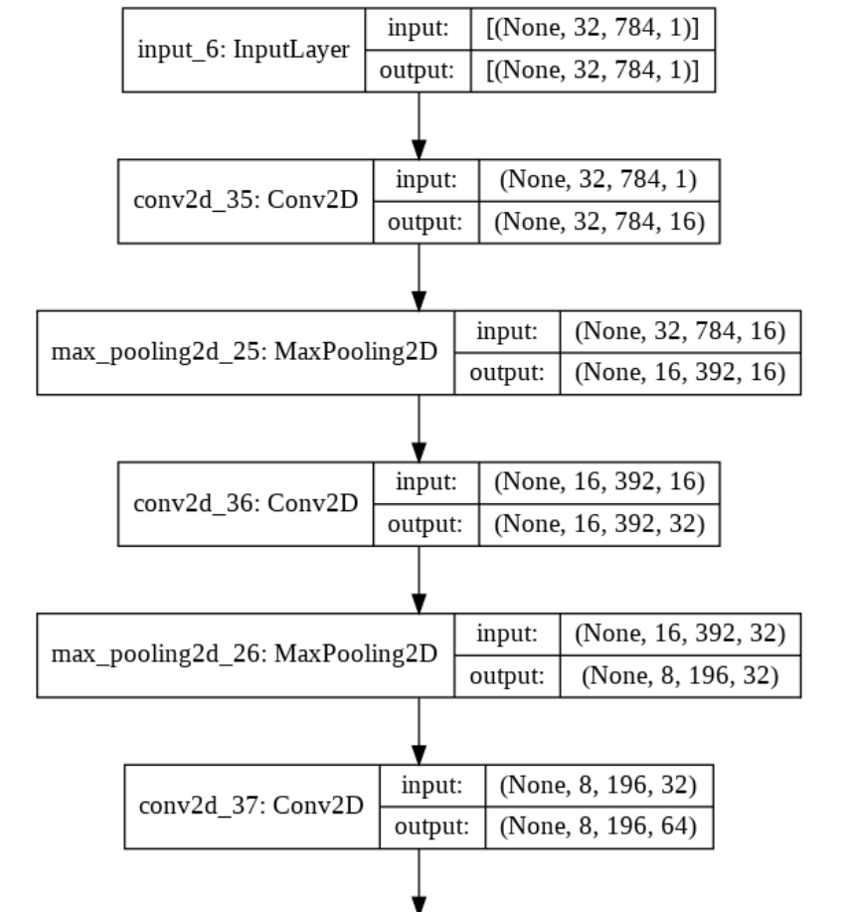
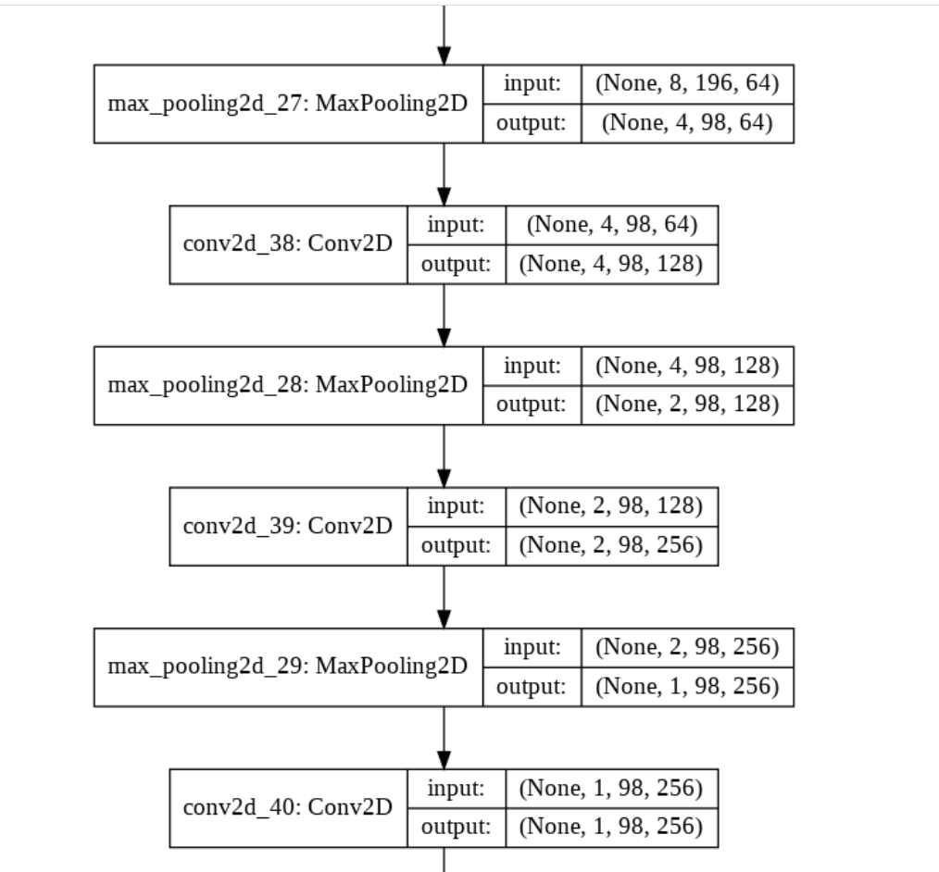
Model Flowchart

Slide 17
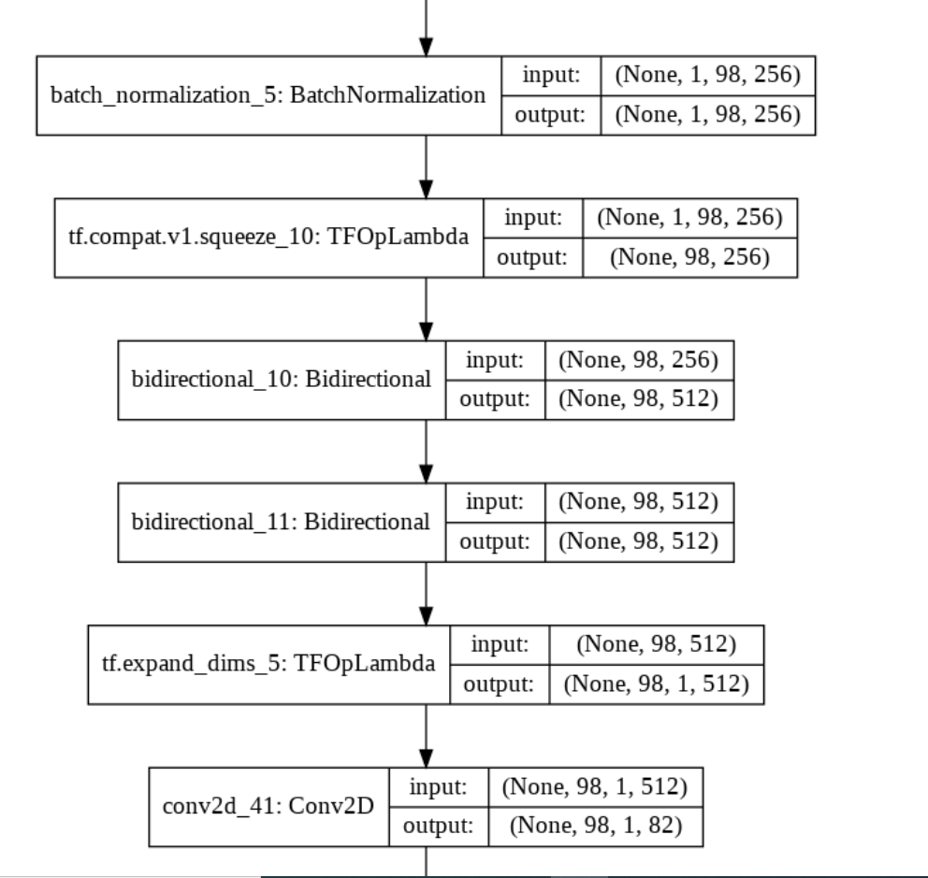
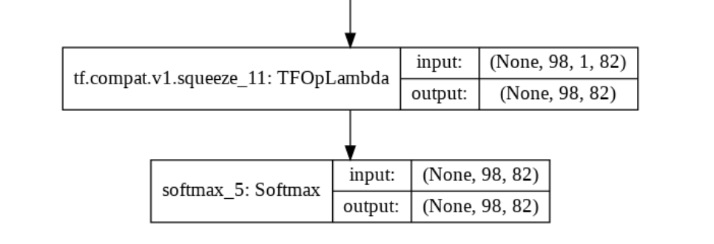

Slide 18
Future scope(OCR)
OCR is finally moving away from just seeing and matching. Driven by deep learning, it's entering a new phase where it first recognizes scanned text, then makes meaning of it. The competitive edge will be given to the software that provides the most powerful information extraction and highest-quality insights.

Slide 19
Conclusion
OCR is a very remarkable technology that holds a lot of potential. In this day and age, such tools are already quite advanced. However, Optical Character Recognition is going to look even better in the future.

Slide 20
References
[1] Project report of OCR Recognition Bharat Kalia
[2] https://www.scribd.com/doc/87514317/Project-Report-OCR
[3]https://www.researchgate.net/publication/329235445_Optical_Recognition_of_Digital_Characters_Using_Machine_Learning
[4]Optical character recognition using back propagation neural network
[5]http://www.ijmlc.org/papers/165-C01330-002.pdf
[6]https://www.google.com/search?q=convolutional+neural+network+figure&sxsrf=ALeKk010QISqTj3yehe9St1ZjqhyF8eLXg:1628712962729&source=lnms&tbm=isch&sa=X&ved=2ahUKEwi9_dXM5KnyAhV44zgGHTS1BH4Q_AUoAXoECAIQAw&biw=1517&bih=631#imgrc=0svziSGdIXcgqM

Slide 21
[7] OCR (Optical Character Recognition) functionality in Node.JS Application
[8] Optical Character Recognition Using Deep Learning Techniques | by Gilad David Maayan | Heartbeat
[9] A gentle introduction to OCR. How and why to apply deep learning to… | by Gidi Shperber
[10] Rizvi, Syed & Abbas, Sagheer & Khan, Muhammad & Asadullah, Muhammad. (2018). Optical Character Recognition System for Nastalique Urdu-Like Script Languages Using Supervised Learning. International Journal of Pattern Recognition and Artificial Intelligence. 33. 10.1142/S0218001419530045.

Slide 22
THANK YOU

